Slide 1
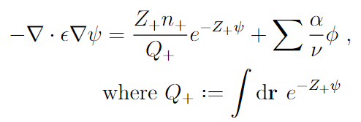
Background
The Poisson—Boltzmann equation must be solved many times during the solving procedure for self-consistent field equations
For the counterion-only system, numerically solving the PB equation is difficult due to the length scale of the decay.
Key characteristics of PB equation
Highly non-linear
One boundary corresponds to charged surface, while other corresponds to charge neutrality of system
Can be numerically solved using NBC—NBC or NBC—DBC (due to compatibility condition/charge neutrality)

Slide 2
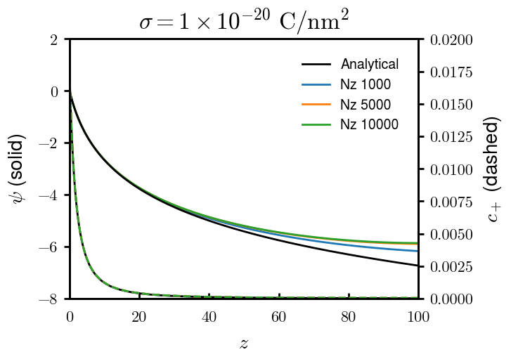
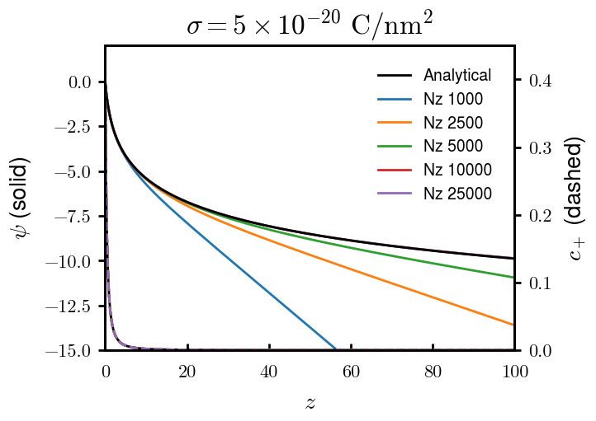
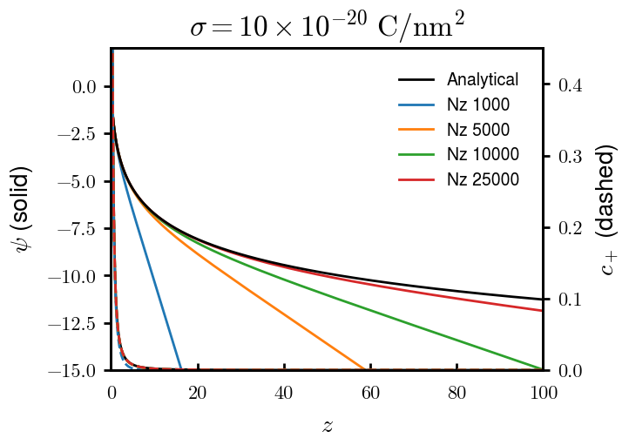
Previous attempts (1 of 4)
Neumann – Dirichlet
Good for 1 uC/nm2, cannot provide natural boundary for higher surface charge densities even for very high N

Slide 3
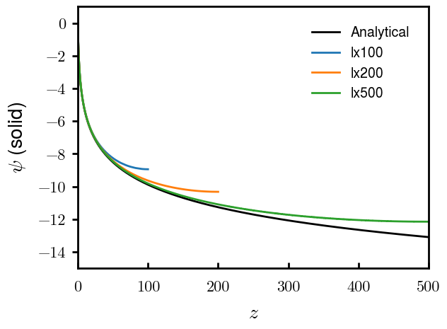
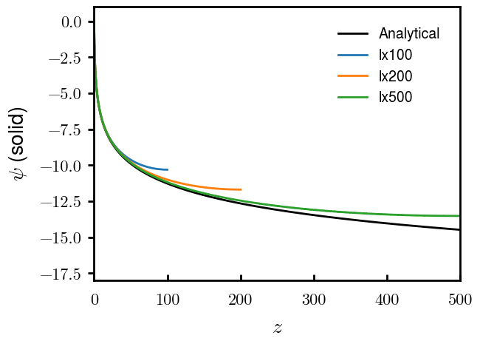
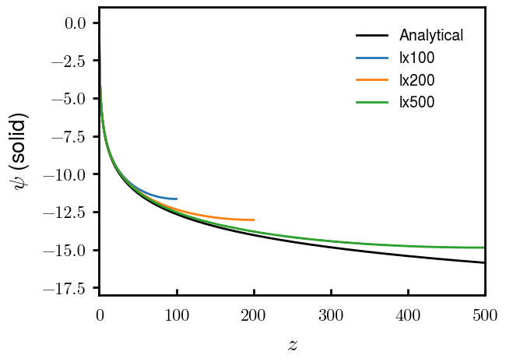
Previous attempts (2 of 4)
Neumann – (D) – Neumann
Neumann on both sides but choose an arbitrary point to set the value of
(Numerically ill-conditioned, but some stackoverflow comments recommended it for similar problems)
−5e-20 C/nm2
−10e-20 C/nm2
−20e-20 C/nm2
Visually okay, but when implemented into full SCFT, very wrong results (not shown)

